Slide 1
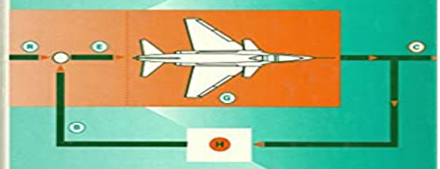
LINEAR CONTROL SYSTEM EE-324 Credit-Hours: 3+1
Dr. Wazir Muhammad
Electrical Engineering Department
BUET, Khuzdar

Slide 2
First Week | Modeling of electrical, mechanical and biological control systems, Open and closed-loop systems
Second Week | Block diagrams, Second order systems, Step and impulse response, Performance criteria, Steady state error.
Third Week | Sensitivity, s-plane system stability.
Fourth Week | Test-1
Fifth Week | Analysis and design with the root loci method.
Sixth week | Frequency domain analysis,
Seventh week | Bode plots,
Eight week | Nyquist criterion,
Ninth week | gain and phase margins,
Tenth week | Nichols charts.
Eleventh week | Test-2
Twelfth week | The State-space method
Thirteenth week | state equations,
Fourteenth week | flow graphs, stability
Sixteenth week | compensation techniques.

Slide 3
Recommended Books:
Katsushiko, Ogata, “Modern Control Engineering,” McGraw-Hill, `5th edition
R. C.Dorf and R. H. Bishop, “Modern Control Systems,” 12th edition
B.C. Kuo, “Automatic Control Systems” 7th edition

Slide 4
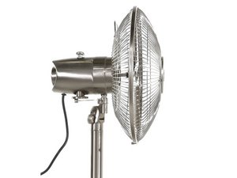
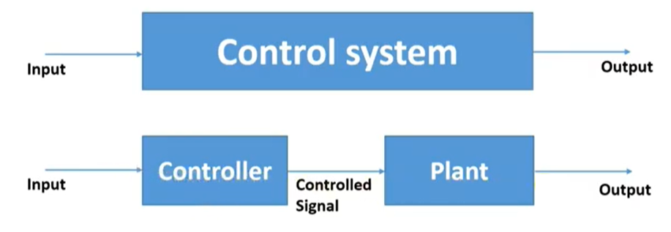
Control Systems
The system whose element are bounded to give desired output is called Control System
Control System
(Fan, AC, Refrigerator etc.)
Controlled I/P
Controlled O/P

Slide 5
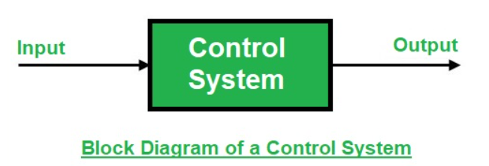
Control Systems
A control system is a set of mechanical or electronic devices that regulates other devices or systems by way of control loops.
A control system is a system, which provides the desired response by controlling the output. The figure below shows the simple block diagram of a control system.
Examples − Traffic lights control system, washing machine, etc.

Slide 6
Example of Water Level
We use water level detector having Inlet and Outlet switch.
Set point is 5 meter (we required water up to 5 meter level).
We used a tab to open and close.
If your water level maintain up to 5 meter than your system work properly.
If water is more than 5 meter your system is disturb, than you open the water tab than again your water level come on 5 meter.
So, water tab is called as Control Action or Control Element
Inlet
5 meter
Control Action/Control Element
Outlet

Slide 7
Quiz
In cold weather you use the room heater system whole night, find out the control action, input and output of this system.
Solution
Input = Electrical Energy
Output = Heat Energy
Action control = ON/OFF Switch

Slide 8
Requirements of a Good Control System
Accuracy (How much your control system is accurate or minimum error)
Stability (Stability means sometimes disturbance occur, after resolve the disturbance and system back in original position means system is stable otherwise system is unstable).
Sensitivity (the quality of being easily upset by the minor fluctuations, like ammeter when disturbance occurs its needle shows fluctuations)
Noise (Control system having ability to block the noise)
Speed (Control system having fast Speed response).
Oscillation (Control system having less oscillation).

Slide 9
Types of Control System
Open Loop Control System
Closed Loop Control System

Slide 10
(1) Open Loop Control System
An open loop control system is a system in which the control action is totally independent of output of the system.
The accuracy of the system depends on the experience of user.
No feedback is used in the Open Loop Control System.

Slide 11
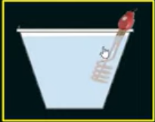
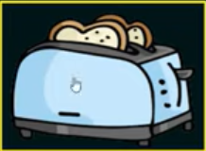
Example of Open Loop Control System
Immersion rod
The immersion rod put inside the water to heat it. It goes on heating the water but does not have a feedback mechanism to tell you how hot the water is and when to stop the water heating, that is the perfect example of open loop control system.
Toaster
Toaster is goes on to increasing the temperature of the bread, but it dose not know when to stop heating, because sometimes we know that toast is to burn.

Slide 12
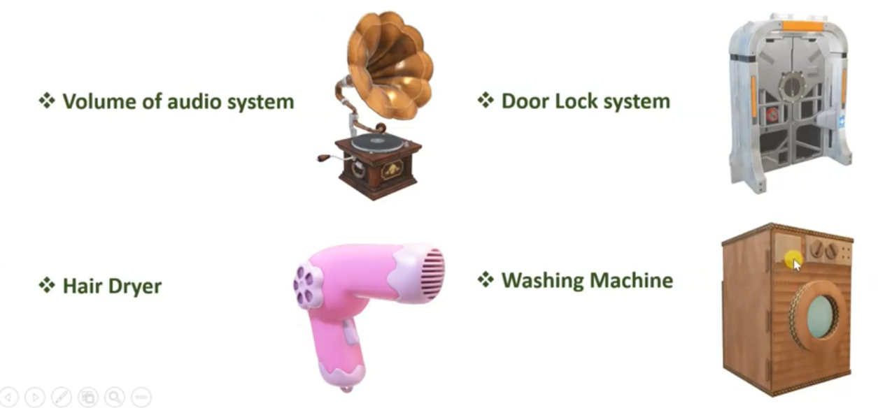
Applications of Open Loop Control System

Slide 13
Advantages Open Loop Control System
Simple in construction and design.
Low cost, because it has no more elements are present in the controller and circuitry is very simple.
It is convenient to use when the output is difficult to measure.
Disadvantages Open Loop Control System
It is poorly equipped to handle disturbance.
It is not reliable, because not efficiently to handle the disturbance.
I is inaccurate.

Slide 14
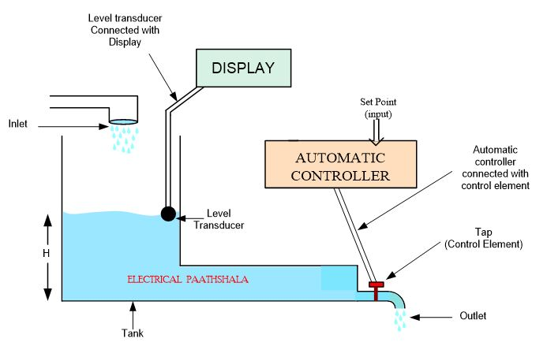
Example of Open Loop Control System
In open loop control system, the feedback is not connected with the automatic controller, it does not mean at all that the level transducer or sensor or feedback is not present in the open loop control system, it is just not connected with the automatic controller as shown in the figure below.
The level transducer is connected with the display, it means if there is a deviation in the height of water in tank then level transducer will note it and send this reading to the display. But, as we can see that there is no feedback value coming to the automatic controller hence, it is unaware of the new height, it did not know that the new height is more than the required or less or equal, Therefore, it can not change the control element position.
Yes, by seeing the display reading, we can manually change the tap position to control the flow or to maintain the height of water. Similarly, You can also think of other examples such as room heater without temperature sensor, water boiling system, normal traffic light system( display is connected to show the timing only, it will not change the timings of lights according to the traffic flow) etc.

Slide 15
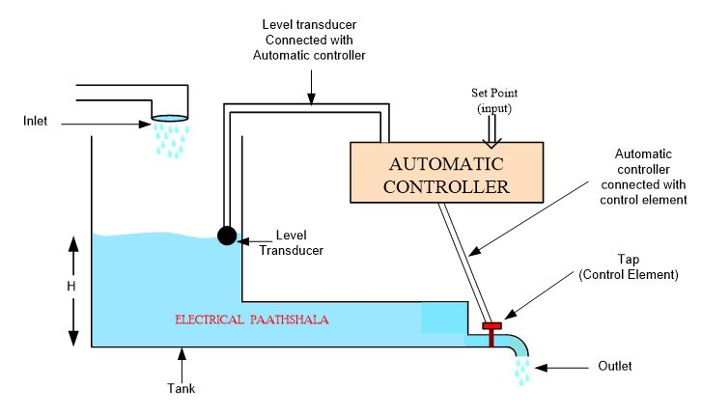
Example of Closed Loop Control System
In this example, we have a task that we must maintain the water level at a desired height (say 5m).
This 5m value is the input (or set point) to the automatic controller, it means that automatic controller will compare the new height with this set point.
A level transducer is placed in the tank to measure the current height of water in the tank, this level transducer is connected with automatic controller, now the value(new height or output) given by the level transducer is compared with the set point(input) by the comparator.
If the new height is more than the set point then the automatic controller will control the control element and opens it, so that the water can flow from the outlet and water level will decreases to desired height again.
If the new height is less than the set point then the automatic controller controls the control element(tap) and closes it, so that water level will increase in the tank and we get the desired output.

Slide 16
(2) Closed Loop Control System
One is forward path means water in and out.
Second is out match with input calculate the error using feedback loop.

Slide 17
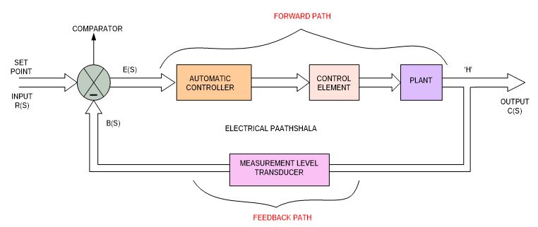
Initially take a PLANT (PLANT is a tank, Inlet, outlet, water all things available in the PLANT).
PLANT connected with Control Element (Tap).
Control Element controlled by controller is known as Automatic Controller.
Automatic Controller work due to error signal E(s).
Error signal generated by Comparator.
Comparator just compare the value of input and feedback to create E(s).
Level Transducer just measure the height above 5 meter and gives to the Comparator.
So one path is called as Forward Path or Forward Path Gain denoted by G(s).
Other path is called as Feedback Path or Feedback Path Gain denoted by H(s)
Figure: Block diagram of closed loop control system

Slide 18
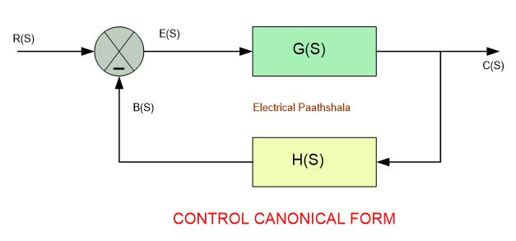
Convert Closed Loop Control System Into Canonical Form
Now we draw canonical form in the G(s) and H(s)
B(s) = Feedback signal
Figure: Block diagram of closed loop control system

Slide 19
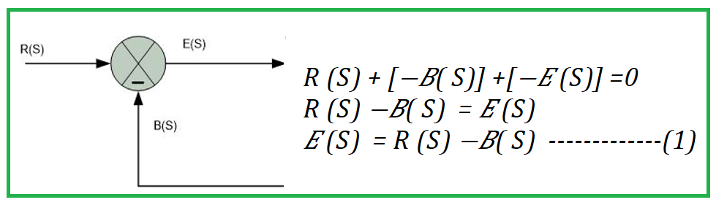
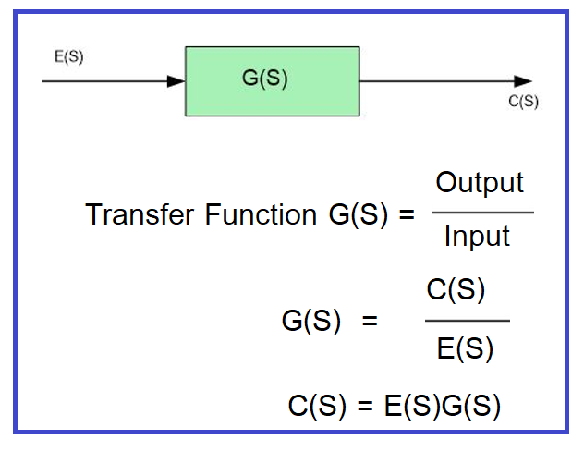
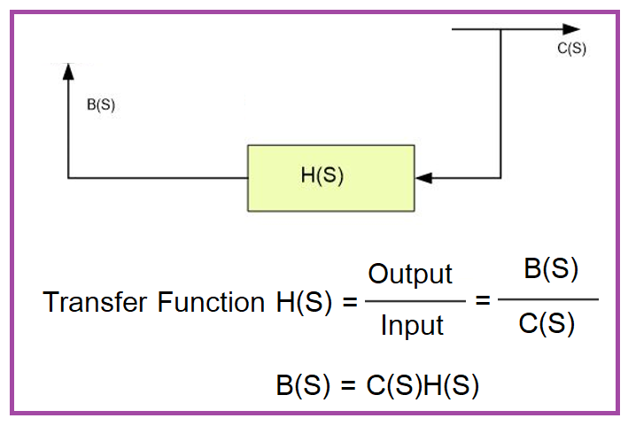

Mathematical Form of Closed Loop Control System
$$R\left(S\right)+\left[−B\left(S\right)\right]−E\left(S\right)=0$$
$$R\left(S\right)−B\left(S\right)=E(S)$$
$$E\left(S\right)=R\left(S\right)−B\left(S\right) −−−−−−−(1)$$
$$C\left(S\right)=E\left(S\right)G\left(S\right)−−−−−−−−−−(2)$$
$$B\left(S\right)=C\left(S\right)H\left(S\right)−−−−−−−−−−(3)$$

Slide 20
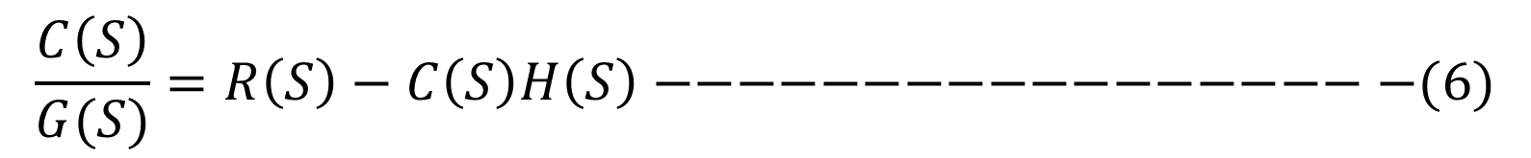
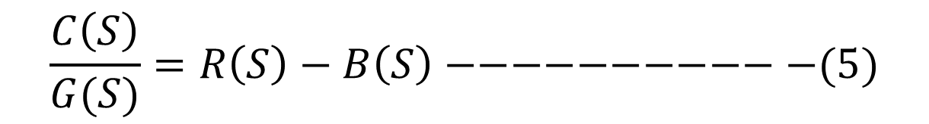
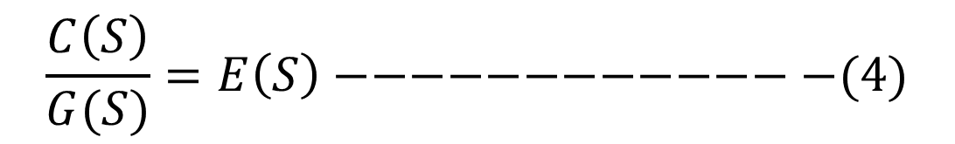
$$E\left(S\right)=R\left(S\right)−B\left(S\right) −−−−−−−(1)$$
$$C\left(S\right)=E\left(S\right)G\left(S\right)−−−−−−−−−−(2)$$
$$B\left(S\right)=C\left(S\right)H\left(S\right)−−−−−−−−−−(3)$$
From equation (2)
$$\frac{C\left(S\right)}{G(S)}=E\left(S\right)−−−−−−−−−−−−−(4)$$
Put the value of E(S) in Equation (4)
$$\frac{C\left(S\right)}{G(S)}=R\left(S\right)−B\left(S\right)−−−−−−−−−−−(5)$$
Put the value of B(S) in Equation (5)
$$\frac{C\left(S\right)}{G(S)}=R\left(S\right)−C\left(S\right)H\left(S\right)−−−−−−−−−−−−−−−−−−(6)$$

Slide 21
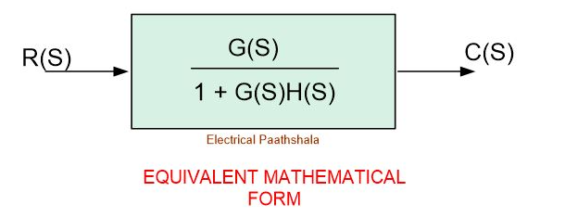

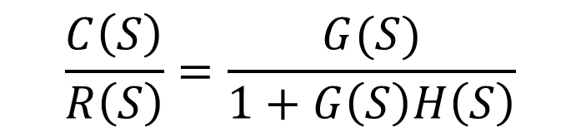
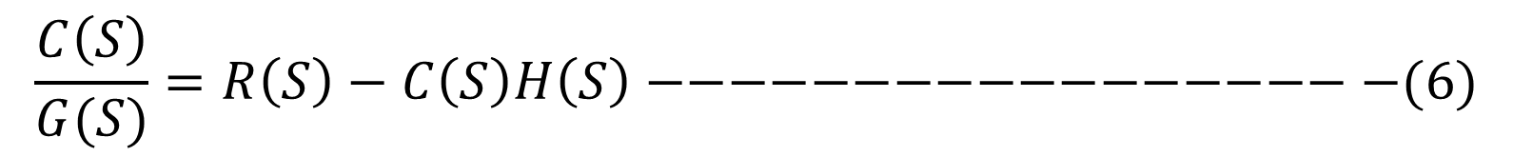
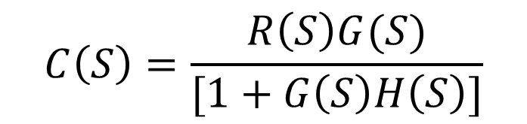


$$\frac{C\left(S\right)}{G(S)}=R\left(S\right)−C\left(S\right)H\left(S\right)−−−−−−−−−−−−−−−−−−(6)$$
$$C\left(S\right)= R\left(S\right)G(S)−C\left(S\right)G(S)H\left(S\right)$$
$$C\left(S\right)+C\left(S\right)G(S)H\left(S\right)= R\left(S\right)G(S)$$
$$C\left(S\right)[1+G\left(S\right)H\left(S\right)]= R\left(S\right)G(S)$$
$$C\left(S\right)=\frac{R\left(S\right)G(S)}{[1+G\left(S\right)H\left(S\right)]}$$
$$\frac{C\left(S\right)}{R\left(S\right)}=\frac{G(S)}{1+G\left(S\right)H\left(S\right)}$$

Slide 22
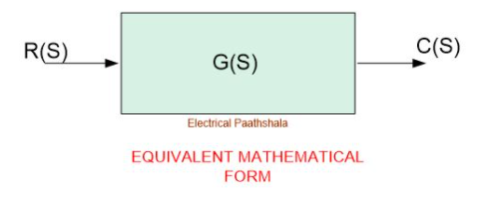
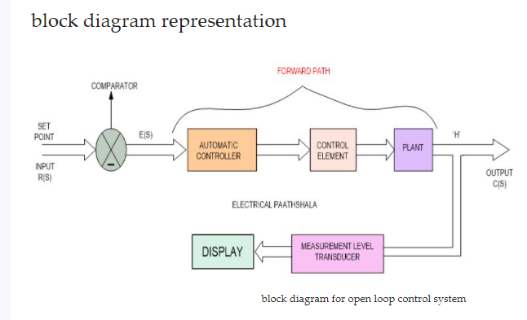

Slide 23
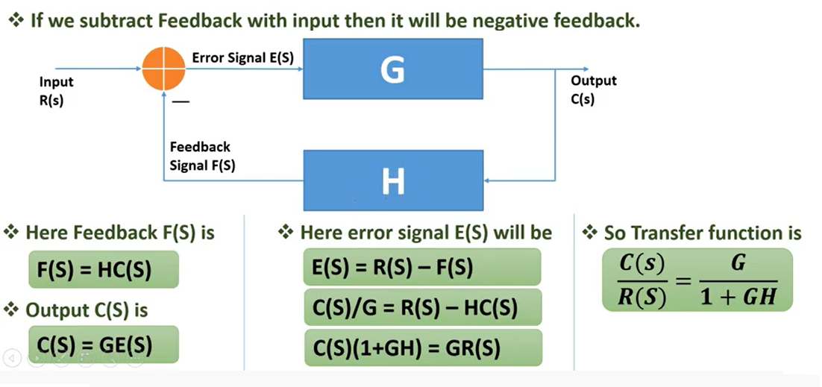
Negative Feedback Closed Loop System
Applications:
Stabilize gain
Amplifier
In ADC/DAC

Slide 24
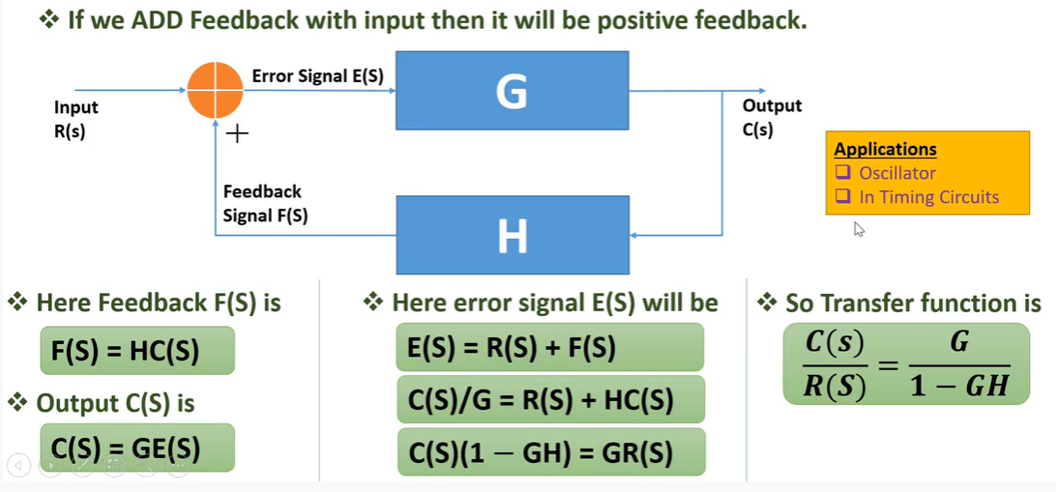
Positive Feedback Closed Loop System

Slide 25
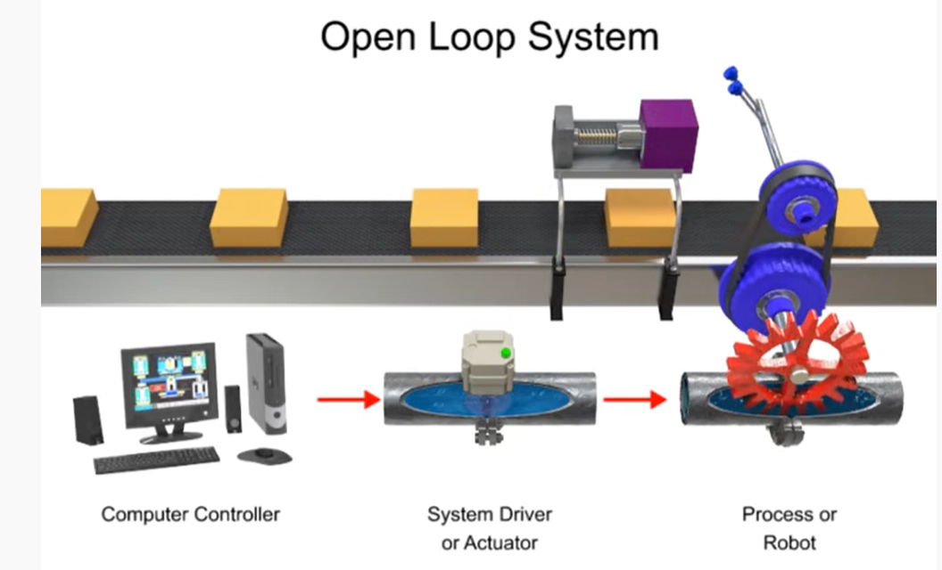
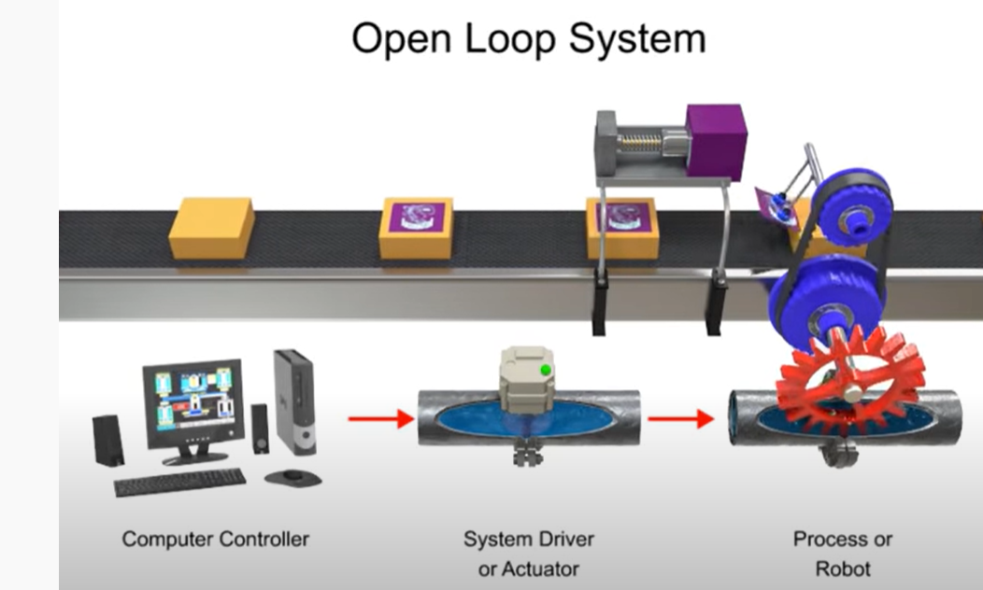

Slide 26
Transfer Function
Transfer Function is the ratio of Laplace Transform of output to the Laplace Transform of input, when all initial conditions are assumed to be zero.
Transfer Function gives the relationship between the Input and the Output

Slide 27
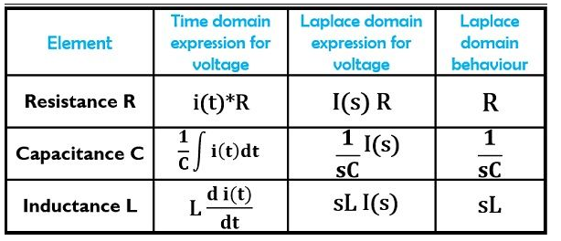
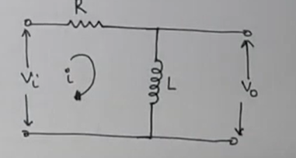
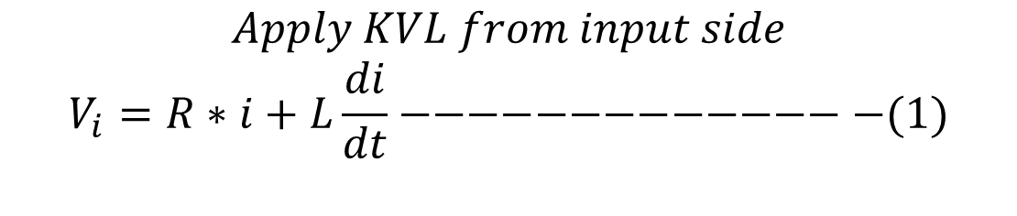
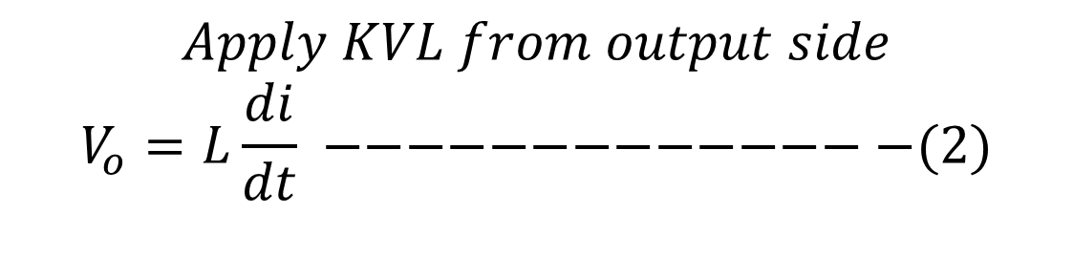
Find the Transfer Function of RL Circuit
$$Apply KVL from input side$$
$$V_{i}=R∗i+L\frac{di}{dt}−−−−−−−−−−−−−−(1)$$
$$Apply KVL from output side$$
$$V_{o}=L\frac{di}{dt} −−−−−−−−−−−−−−(2)$$

Slide 28

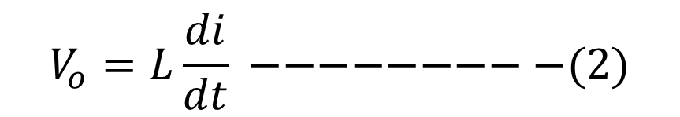
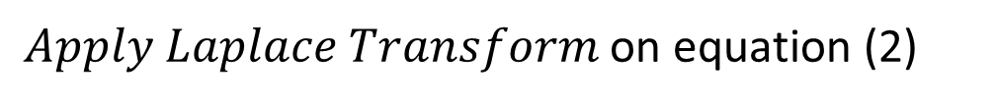
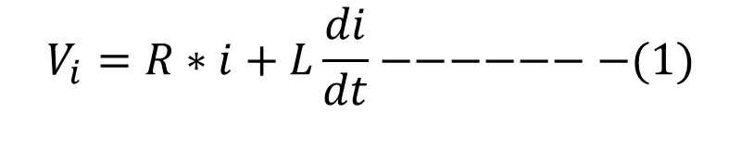
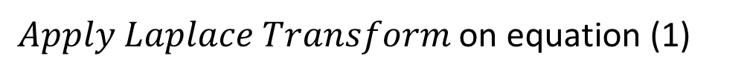


Find the Transfer Function of RL Circuit
$Apply Laplace Transform$ on equation (1)
$$V_{i}\left(s\right)=R∗I\left(s\right)+sLI\left(s\right)=\left(R+sL\right)I(s)$$
$Apply Laplace Transform$ on equation (2)
$$V_{o}(s)=sLI(s)$$
$$Transfer Function=\frac{Output}{Input}=\frac{V_{o}\left(s\right)}{V_{i}\left(s\right)}=\frac{sLI(s)}{\left(R+sL\right)I(s)}$$
$$V_{i}=R∗i+L\frac{di}{dt}−−−−−−−(1)$$
$$Transfer Function=\frac{Output}{Input}=\frac{sL}{\left(R+sL\right)}=\frac{sL}{R+sL}$$
$$V_{o}=L\frac{di}{dt} −−−−−−−−−(2)$$

Slide 29
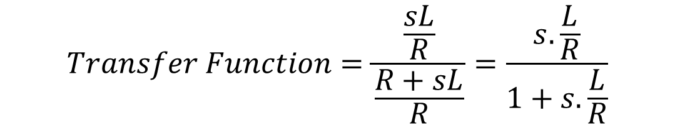
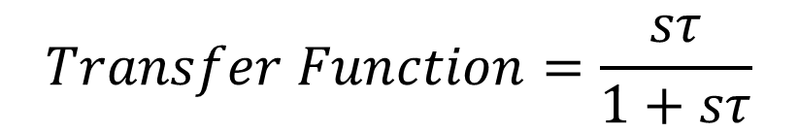
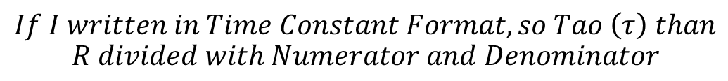

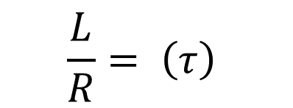
Find the Transfer Function of RL Circuit
$$Transfer Function=\frac{Output}{Input}=\frac{sL}{R+sL}$$
$$If I written in Time Constant Format, so Tao \left(τ\right) than$$
$$R divided with Numerator and Denominator$$
$$Transfer Function=\frac{\frac{sL}{R}}{\frac{R+sL}{R}}=\frac{s.\frac{L}{R}}{1+s.\frac{L}{R}}$$
$$V_{i}=R∗i+L\frac{di}{dt}−−−−−−−(1)$$
$$\frac{L}{R}= \left(τ\right)$$
$$V_{o}=L\frac{di}{dt} −−−−−−−−−(2)$$
$$Transfer Function=\frac{sτ}{1+sτ}$$

Slide 30
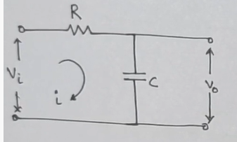
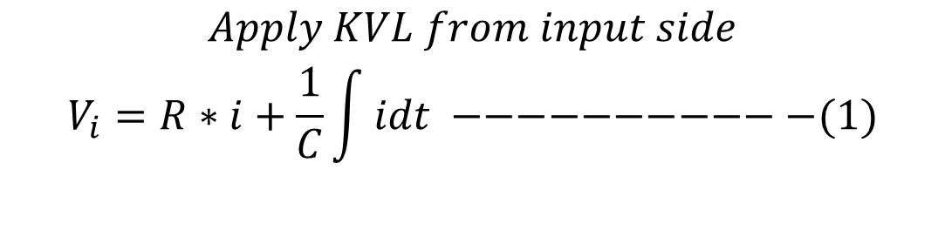
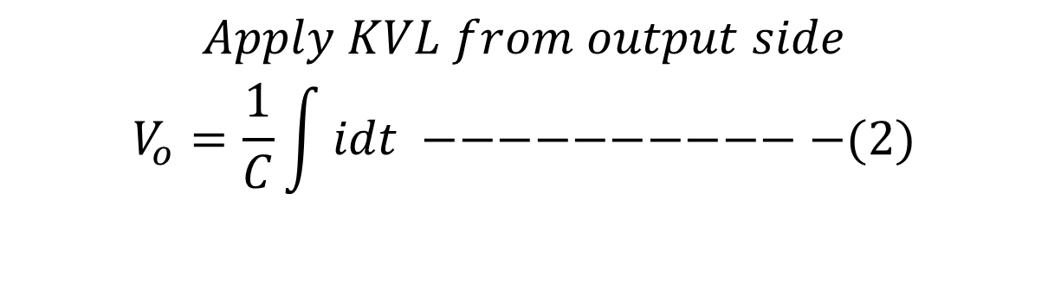
Find the Transfer Function of RC Circuit
$$Apply KVL from input side$$
$$V_{i}=R∗i+\frac{1}{C}\int{idt −−−−−−−−−−−(1)}$$
$$Apply KVL from output side$$
$$V_{o}=\frac{1}{C}\int{idt −−−−−−−−−−−(2)}$$

Slide 31
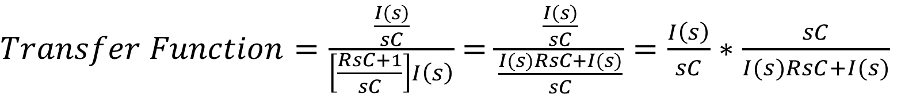
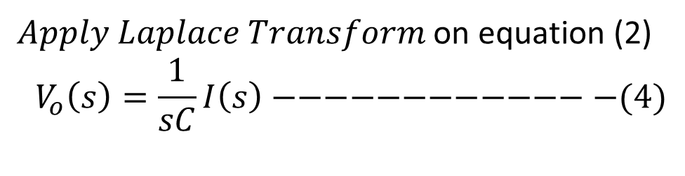

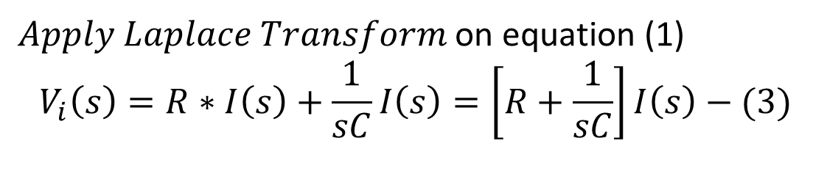
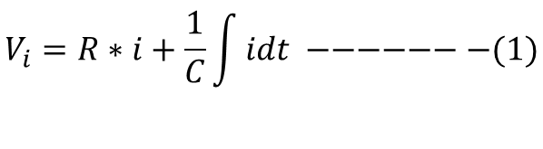
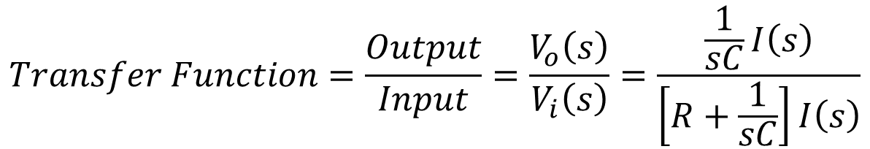
Find the Transfer Function of RC Circuit
$Apply Laplace Transform$ on equation (1)
$$V_{i}\left(s\right)=R∗I\left(s\right)+\frac{1}{sC}I\left(s\right)=\left[R+\frac{1}{sC}\right]I\left(s\right)−(3)$$
$Apply Laplace Transform$ on equation (2)
$$V_{o}\left(s\right)=\frac{1}{sC}I\left(s\right)−−−−−−−−−−−−−(4)$$
$$Transfer Function=\frac{Output}{Input}=\frac{V_{o}\left(s\right)}{V_{i}\left(s\right)}=\frac{\frac{1}{sC}I\left(s\right)}{\left[R+\frac{1}{sC}\right]I\left(s\right)}$$
$$V_{i}=R∗i+\frac{1}{C}\int{idt −−−−−−−(1)}$$
$$V_{o}=\frac{1}{C}\int{idt −−−−−−−−−(2)}$$
$Transfer Function=\frac{\frac{I\left(s\right)}{sC}}{\left[\frac{RsC+1}{sC}\right]I\left(s\right)}$ $=\frac{\frac{I\left(s\right)}{sC}}{\frac{I(s)RsC+I(s)}{sC}}=\frac{I\left(s\right)}{sC}∗$ $\frac{sC}{I(s)RsC+I(s)}$

Slide 32
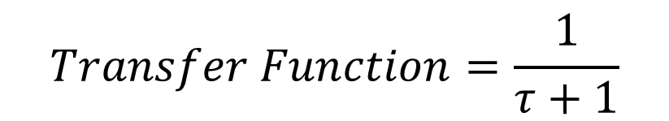
Find the Transfer Function of RC Circuit
$Transfer Function=\frac{\frac{I\left(s\right)}{sC}}{\left[\frac{RsC+1}{sC}\right]I\left(s\right)}$ $=\frac{\frac{I\left(s\right)}{sC}}{\frac{I(s)RsC+I(s)}{sC}}=\frac{I\left(s\right)}{sC}∗$ $\frac{sC}{I(s)RsC+I(s)}$
$Transfer Function=\frac{I(s)}{I\left(s\right)[RsC+1]}$ $=\frac{1}{ [RsC+1]}$ $=\frac{1}{RsC+1}$
$$If I written in Time Constant Format, so Tao (τ)=RsC$$
$$Transfer Function=\frac{1}{τ+1}$$

Slide 33
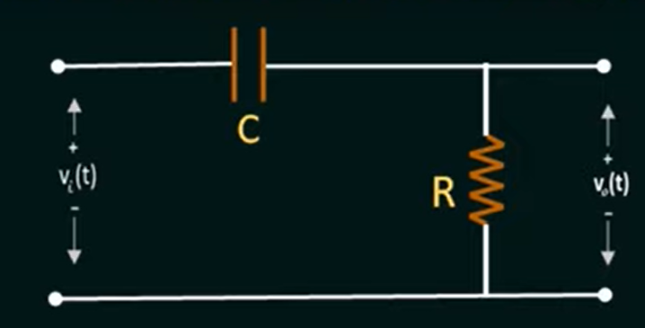

Find the Transfer Function of CR Circuit
Convert Time Domain CKT into S-Domain

Slide 34


Find the Transfer Function of RC Circuit
$$Total Opposition=\frac{1}{sC}+R$$
$$Volatge Acroos R, we used VDSR V_{o}\left(s\right)=\frac{V_{i}\left(s\right) ∗R}{Total Opposition}$$
$$V_{o}\left(s\right)=\frac{V_{i}\left(s\right) ∗R}{\frac{1}{sC}+R}$$

Slide 35



Find the Transfer Function of RC Circuit
$$V_{o}\left(s\right)=\frac{V_{i}\left(s\right) ∗R}{\frac{1}{sC}+R}$$
$$\frac{V_{o}\left(s\right)}{V_{i}\left(s\right)}=\frac{R}{\frac{1}{sC}+R}=\frac{R}{\frac{1+sCR}{sC}}=R ÷\frac{1+sCR}{sC}$$
$$\frac{V_{o}\left(s\right)}{V_{i}\left(s\right)}=R ×\frac{sC}{1+sCR}=\frac{RsC}{RsC+1}$$
$$Transfer Function=H\left(s\right)=\frac{Output}{Input}=\frac{V_{o}\left(s\right)}{V_{i}\left(s\right)}=R ×\frac{sC}{1+sCR}=\frac{RsC}{RsC+1}$$

Slide 36



Find the Transfer Function of RLC Circuit
$$E_{i}\left(t\right)=Ri\left(t\right)+L\frac{di\left(t\right)}{dt}+\frac{1}{c}\int{i\left(t\right)dt−−−−−−−−−(1)}$$
$$E_{o}\left(t\right)=\frac{1}{c}\int{i\left(t\right)dt} −−−−−−−−−−−−−−−−−−−(2)$$

Slide 37






Find the Transfer Function of RLC Circuit
$Apply Laplace Transform$ on equation (1)
$$E_{i}\left(s\right)=R∗I\left(s\right)+sLI\left(s\right)+\frac{1}{sc}I\left(s\right)$$
$Apply Laplace Transform$ on equation (2)
$$E_{o}\left(s\right)=\frac{1}{sc}I\left(s\right)$$
$$E_{i}\left(t\right)=Ri\left(t\right)+L\frac{di\left(t\right)}{dt}+\frac{1}{c}\int{i\left(t\right)dt−−−−(1)}$$
$$E_{o}\left(t\right)=\frac{1}{c}\int{i\left(t\right)dt} −−−−−−−−−−−(2)$$
$$Transfer Function=\frac{Output}{Input}=\frac{E_{o}\left(s\right)}{E_{i}\left(s\right)}=\frac{\frac{1}{sC}I\left(s\right)}{\left[R∗I\left(s\right)+sLI\left(s\right)+\frac{1}{sc}I\left(s\right)\right]}$$
$$Transfer Function=\frac{Output}{Input}=\frac{E_{o}\left(s\right)}{E_{i}\left(s\right)}=\frac{\frac{1}{sC}I\left(s\right)}{\left[R+sL+\frac{1}{sc}\right]I(s)}=\frac{\frac{1}{sC}}{\left[R+sL+\frac{1}{sc}\right]}=\frac{\frac{1}{sC}}{\left[\frac{RsC+s^{2}LC+1}{sC}\right]}$$

Slide 38


Find the Transfer Function of RLC Circuit
$$Transfer Function=\frac{Output}{Input}=\frac{E_{o}\left(s\right)}{E_{i}\left(s\right)}=\frac{\frac{1}{sC}I\left(s\right)}{\left[R+sL+\frac{1}{sc}\right]I(s)}=\frac{\frac{1}{sC}}{\left[R+sL+\frac{1}{sc}\right]}=\frac{\frac{1}{sC}}{\left[\frac{RsC+s^{2}LC+1}{sC}\right]}$$
$$Transfer Function=\frac{\frac{1}{sC}}{\left[\frac{RsC+s^{2}LC+1}{sC}\right]}=\frac{1}{sC} ∗\frac{sC}{{RsC+s}^{2}LC+1}=\frac{1}{LCs^{2}+RCs+1}$$

Slide 39

TABLE OF LAPLACE TRANSFORM
Time Domain | Laplace Domain
$$t$$ | $$s$$
$$i\left(t\right)$$ | $$I\left(s\right)$$
$$y\left(t\right)$$ | $$Y\left(s\right)$$
$$\frac{dy\left(t\right)}{dt}$$ | $$s.Y\left(s\right)−y(0^{−})$$
$$\frac{di\left(t\right)}{dt}$$ | $$s.I\left(s\right)−i(0^{−})$$
$$L\frac{di\left(t\right)}{dt}$$ | $$s.LI\left(s\right)−Li(0^{−})$$
$$\frac{d^{2}y\left(t\right)}{{dt}^{2}}$$ | $$s^{2}.Y\left(s\right)−y\left(0^{−}\right)− y^{′}(0^{−})$$
$$\int{i\left(t\right)dt}$$ | $$\frac{1}{s}I(s)$$
$$\frac{1}{C}\int{i\left(t\right)dt}$$ | $$\frac{1}{sC}I(s)$$

Slide 40


Find The Transfer Function
Example: Find the Transfer Function of the System is given by:
$$\frac{d^{2}y\left(t\right)}{{dt}^{2}} +3.\frac{dy\left(t\right)}{dt}+2.y\left(t\right)=x\left(t\right) where:x\left(t\right)is the input \& y\left(t\right)is the output$$
Solution:
$$s^{2}.Y\left(s\right)−y\left(0^{−}\right)− y^{′}\left(0^{−}\right)+3.\left[s.Y\left(s\right)−y\left(0^{−}\right)\right]+2.Y\left(s\right)=X(s)$$
All initial conditions are zero
$$s^{2}.Y\left(s\right)+3s.Y\left(s\right) +2.Y\left(s\right)=X(s)$$
$${Y\left(s\right)[s}^{2}+3s +2] = X(s)$$
$$Y\left(s\right)=\frac{X\left(s\right)}{s^{2}+3s+2}$$
$$Transfer Function=\frac{Output}{Input}= \frac{Y\left(s\right)}{X(s)}=\frac{1}{s^{2}+3s+2} −−−Answer$$

Slide 41
Proper Transfer Function
A Transfer Function having Numerator Degree is less than or equal to Denominator (N ≤ D), than such type of Transfer Function is called as Proper Transfer Function.
$$H\left(s\right)=\frac{1}{(s+2)(s+3)} −−−−−−−−−\left(N<D\right)−−−It is Proper T.F$$
$$H\left(s\right)=\frac{s^{2}+1}{{2s}^{2}+5} −−−−−−−−−−(N≤D)−−−−−−It is Proper T.F$$

Slide 42
Strictly Proper Transfer Function
A Transfer Function having Numerator Degree is only less than Denominator (N < D), than such type of Transfer Function is called as Proper Transfer Function.
$$H\left(s\right)=\frac{s}{{3s}^{2}+4} −−−−−−−−−\left(N<D\right)−−−It is Strictly Proper T.F$$

Slide 43
Improper OR Not Proper Transfer Function
A Transfer Function having Numerator Degree is greater than Denominator (N>D), than such type of Transfer Function is called as Improper Transfer Function.
$$H\left(s\right)=\frac{{3s}^{2}+7}{s^{2}+2} −−−−−−−−−−(N>D)−−−−−It is Improper T.F$$

Slide 44
Poles And Zeros Of Transfer Function
Zeros: Zeros of a Transfer Function are the frequencies (values of s) for which the numerator of the transfer function becomes zero.
Poles: Poles of a Transfer Function are the frequencies (values of s) for which the denominator of the transfer function becomes zero.

Slide 45




Q: Find the Poles And Zeros Of Transfer Function
$$H\left(s\right)=\frac{(s+2)}{(s+3)(s+4)}$$
$$Solution:$$
$$H\left(s\right)=\frac{Zeros}{Poles}= \frac{(s+2)}{(s+3)(s+4)}$$
$$Zeros:s=−2$$
$$Poles:s=−3, s=−4$$

Slide 46

Q: Write the MATLAB Code Of Transfer Function
$$H\left(s\right)=\frac{(s+2)}{(s+3)(s+4)}$$
$$Solution:$$
$$H\left(s\right)=\frac{Zeros}{Poles}= \frac{(s+2)}{(s+3)(s+4)}=\frac{(s+2)}{(s^{2}+3s+4s+12)}=\frac{(s+2)}{(s^{2}+7s+12)}$$
>> numerator = [1 2];
>> denominator = [1 7 12];
>> sys = tf(numerator, denominator)
sys =
s + 2
--------------
s^2 + 7 s + 12
Continuous-time transfer function.
plot(sys)

Slide 47

Pole-Zero Diagram
Plot on s-plane which represents the location of Poles and Zeros of a Transfer Function is called as Pole-Zero Diagram.
Poles are represented by ×
Zeros are represented by
X-axis is sigma-axis (real part of x)
Y-axis is the jω-axis which is the imaginary part of x

Slide 48


Q: Find the Poles And Zeros Of Transfer Function and Draw the Pole – Zero Diagram
$$H\left(s\right)=\frac{(s+2)}{(s+3)(s+4)}$$
$$Solution:$$
$$H\left(s\right)=\frac{Zeros}{Poles}= \frac{(s+2)}{(s+3)(s+4)}$$
$$Zeros:s=−2$$
$$Poles:s=−3, s=−4$$

Slide 49






Q: Find the Poles And Zeros Of Transfer Function and Draw the Pole – Zero Diagram
$$jσ$$
$$H\left(s\right)=\frac{(s+2)}{(s+3)(s+4)}$$
$$H\left(s\right)=\frac{Zeros}{Poles}= \frac{(s+2)}{(s+3)(s+4)}$$
$$−σ$$
$$σ$$
-5 -4 -3 -2 -1
1 2 3 4 5
$$H\left(s\right)=\frac{Zeros}{Poles}= \frac{(s+2)}{(s+3)(s+4)}$$
$$Zeros:s=−2$$
$$Poles:s=−3, s=−4$$
$$−jσ$$

Slide 50







Q: Find the Poles And Zeros Of Transfer Function and Draw the Pole – Zero Diagram
$$jσ$$
$$H\left(s\right)=\frac{5s}{(s+1)(s^{2}+4s+8)}$$
$$2j$$
$$j$$
$$H\left(s\right)=\frac{Zeros}{Poles}= \frac{5s}{(s+1)(s^{2}+4s+8)}=\frac{5s}{(s+1)(s+2−2j)(s+2+2j)}$$
$$−σ$$
$$σ$$
-5 -4 -3 -2 -1
1 2 3 4 5
$$−j$$
-$2j$
$$Zeros:s=0$$
$$Poles:s=−1, \left(−2+2j\right), (2−2j)$$
$$−jσ$$

Slide 51



